Slide 1
CS 355/555
Probability and Statistics for CS
Baocheng Geng
Lecture 20, 03/17/2025
CS 355/555 Probability and Statistics for CS

Slide 2




Table of Contents
Moments
Cumulative Distribution Functions Cumulative Distribution Functions
3
Continuous Uniform Random Variable Examples
Geometric and Exponential Random Variables
4
4 Next Class - 3.3
CS 355/555 Probability and Statistics for CS

Slide 3
Cumulative Distribution Function
Recall for discrete Random Variables:
X is a Random Variable, there is a Probability Mass Function:
p_{X} (x) = P (X = x)
CS 355/555 Probability and Statistics for CS
4/24 11:00

Slide 4
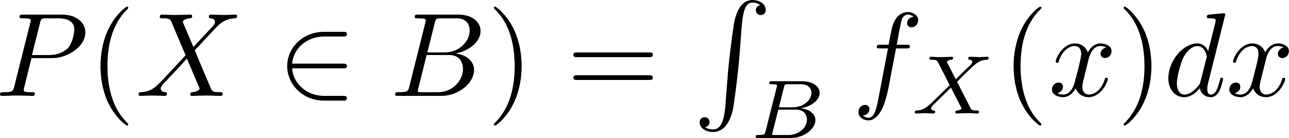
Cumulative Distribution Function
Recall for discrete Random Variables:
X is a Random Variable, there is a Probability Mass Function:
p_{X} (x) = P (X = x)
Also,from last class, the Probability Distribution Function for continuous Random Variables:
f_{X} (x)
used to define
CS 355/555 Probability and Statistics for CS
4/24 11:00

Slide 5
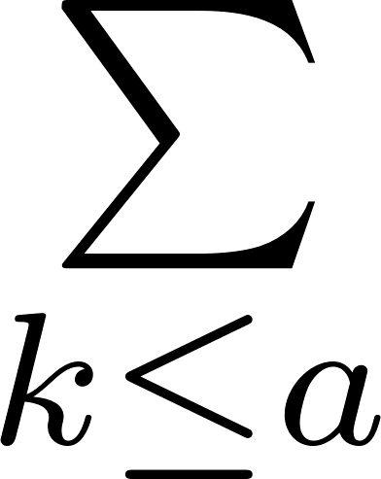
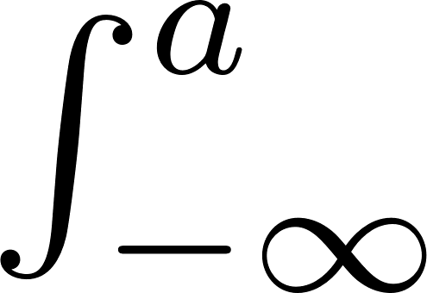
Cumulative Distribution Function
Define the Cumulative Distribution Function:
Discrete
F (a) = P (X ≤ a) = p (k)
X X
Continuous
F_{X} (a) = P (X ≤ a) =
f_{X} (x) dx
CS 355/555 Probability and Statistics for CS
5/24 11:00

Slide 6
Cumulative Distribution Function
Define the Cumulative Distribution Function:
Discrete
F (a) = P (X ≤ a) = p (k)
X X
Continuous
F_{X} (a) = P (X ≤ a) =
f_{X} (x) dx
The Cumulative Distribution Function accumulates probability up to a.
CS 355/555 Probability and Statistics for CS
5/24 11:00

Slide 7
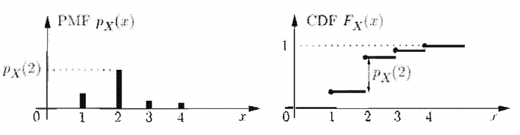
Cumulative Distribution Function
Fig 3.6 - discrete
CS 355/555 Probability and Statistics for CS

Slide 8
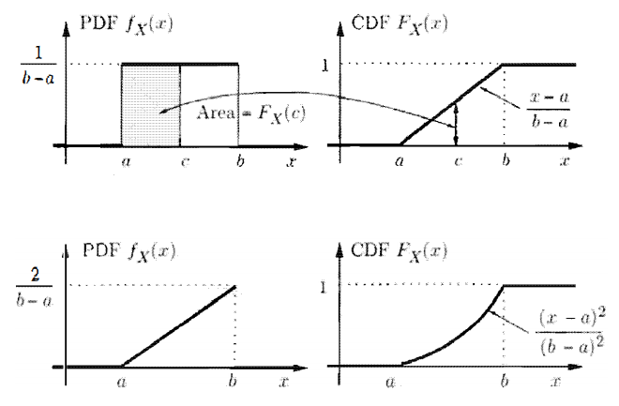
Cumulative Distribution Function
Fig 3.7 - continuous
CS 355/555 Probability and Statistics for CS

Slide 9
Example: Uniform Random Variable
0
x < a
if a ≤ x ≤ b x > b
f_{X} (x) = c =
1
b−a
₀
CS 355/555 Probability and Statistics for CS
10/24 11:00

Slide 10

Example: Uniform Random Variable
0
x < a
if a ≤ x ≤ b x > b
f_{X} (x) = c =
1
b−a
₀
x x
x − a
F_{X} (x) = c dt = c dt = c(x − a) = _{b − a}
CS 355/555 Probability and Statistics for CS
10/24 11:00

Slide 11
Example: Uniform Random Variable
0
x < a
if a ≤ x ≤ b x > b
f_{X} (x) = c =
1
b−a
₀
x x
x − a
F_{X} (x) = c dt = c dt = c(x − a) = _{b − a}
a a
Note the assumption: a ≤ x ≤ b
0
1
b−a
0
x < a
if a ≤ x ≤ b x > b
F ′ (x) =
= f_{X} (x)
X
CS 355/555 Probability and Statistics for CS
10/24 11:00

Slide 12
Example f to F
X Random Variable, f_{X} (x) = 2x : [0, 1]
CS 355/555 Probability and Statistics for CS
11/24 11:00

Slide 13
Example f to F
X Random Variable, f_{X} (x) = 2x : [0, 1]
x x
( )
1
2 x
2
F_{X} (x) = 2t dt = 2 t dt = 2 ₂ t |₀ = x
0 0
CS 355/555 Probability and Statistics for CS
11/24 11:00

Slide 14
Example f to F
X Random Variable, f_{X} (x) = 2x : [0, 1]
x x
( )
1
2 x
2
F_{X} (x) = 2t dt = 2 t dt = 2 ₂ t |₀ = x
0 0
0 x < 0
if 0 ≤ x ≤ 1 x > 1
F_{X} (x) =
_{x}2
₁
CS 355/555 Probability and Statistics for CS
11/24 11:00

Slide 15
Properties of a CDF Box pg 150
F_{X} (x) = P (X ≤ x)
CS 355/555 Probability and Statistics for CS
8/24 11:00

Slide 16
Properties of a CDF Box pg 150
F_{X} (x) = P (X ≤ x)
F_{X} is monotonic increasing
x ≤ y ⇒ F_{X} (x) ≤ F_{X} (y)
CS 355/555 Probability and Statistics for CS
8/24 11:00

Slide 17
Properties of a CDF Box pg 150
F_{X} (x) = P (X ≤ x)
F_{X} is monotonic increasing
x ≤ y ⇒ F_{X} (x) ≤ F_{X} (y)
lim F_{X} (x) → 0
x→−∞
CS 355/555 Probability and Statistics for CS
8/24 11:00

Slide 18
Properties of a CDF Box pg 150
F_{X} (x) = P (X ≤ x)
F_{X} is monotonic increasing
x ≤ y ⇒ F_{X} (x) ≤ F_{X} (y)
lim F_{X} (x) → 0
x→−∞
lim F_{X} (x) → 1
x→∞
CS 355/555 Probability and Statistics for CS
8/24 11:00

Slide 19
Properties of a CDF Box pg 150
F_{X} (x) = P (X ≤ x)
F_{X} is monotonic increasing
x ≤ y ⇒ F_{X} (x) ≤ F_{X} (y)
lim F_{X} (x) → 0
x→−∞
lim F_{X} (x) → 1
x→∞
if f_{X} (x) is discrete then F_{X} (x) is piecewise constant (Fig 3.6)
CS 355/555 Probability and Statistics for CS
8/24 11:00

Slide 20
Properties of a CDF Box pg 150
F_{X} (x) = P (X ≤ x)
F_{X} is monotonic increasing
x ≤ y ⇒ F_{X} (x) ≤ F_{X} (y)
lim F_{X} (x) → 0
x→−∞
lim F_{X} (x) → 1
x→∞
if f_{X} (x) is discrete then F_{X} (x) is piecewise constant (Fig 3.6) if f_{X} (x) is continuous then F_{X} (x) is continuous (Fig 3.7)
CS 355/555 Probability and Statistics for CS
8/24 11:00

Slide 21
Properties of a CDF Box pg 150
x
F_{X} (x) = P (X ≤ x) =
f_{X} (t) dt means
−∞
f_{X} (x) = F ′ (x)
X
CS 355/555 Probability and Statistics for CS
9/24 11:00

Slide 22
Properties of a CDF Box pg 150
x
F_{X} (x) = P (X ≤ x) =
f_{X} (t) dt means
−∞
f_{X} (x) = F ′ (x)
X
Sometimes, it is easier to calculate the CDF then calculate the PDF from the CDF by taking the derivative.
CS 355/555 Probability and Statistics for CS
9/24 11:00

Slide 23
Example 3.6, page 150 - More complicated
You are allowed to take a test three times. and your final score on the test is the maximum of the three scores. Your score on the three tests is a random integer from 1 to 10.
The test scores are independent (that is, you didn’t learn anything from test to test).
CS 355/555 Probability and Statistics for CS
12/24 11:00

Slide 24
Example 3.6, page 150 - More complicated
You are allowed to take a test three times. and your final score on the test is the maximum of the three scores. Your score on the three tests is a random integer from 1 to 10.
The test scores are independent (that is, you didn’t learn anything from test to test).
Calculate the PMF of X = max(X₁, X₂, X₃), test scores, X_{i} Uniform Random Variable in [1, 2, 3, 4, 5, 6, 7, 8, 9, 10].
CS 355/555 Probability and Statistics for CS
12/24 11:00

Slide 25
Example 3.6, page 150 - More complicated
Calculate the CDF:
F_{X} (k) = P (X ≤ k)
CS 355/555 Probability and Statistics for CS
13/24 11:00

Slide 26
Example 3.6, page 150 - More complicated
Calculate the CDF:
F_{X} (k) = P (X ≤ k)
= P (X₁ ≤ k, X₂ ≤ k, X₃ ≤ k)
CS 355/555 Probability and Statistics for CS
13/24 11:00

Slide 27
Example 3.6, page 150 - More complicated
Calculate the CDF:
F_{X} (k) = P (X ≤ k)
= P (X₁ ≤ k, X₂ ≤ k, X₃ ≤ k)
= P (X₁ ≤ k) × P (X₂ ≤ k) × P (X₃ ≤ k)
CS 355/555 Probability and Statistics for CS
13/24 11:00

Slide 28
Example 3.6, page 150 - More complicated
Calculate the CDF:
F_{X} (k) = P (X ≤ k)
= P (X₁ ≤ k, X₂ ≤ k, X₃ ≤ k)
= P (X₁ ≤ k) × P (X₂ ≤ k) × P (X₃ ≤ k)
( )
k
10
3
=
CS 355/555 Probability and Statistics for CS
13/24 11:00

Slide 29
Example 3.6, page 150 - More complicated
( )
k
3
k | _{k}3 | ^{X} 10 | p_{X} (k)
1 | 1 | 0.001 | 0.001 | 1
2 | 8 | 0.008 | 0.007 | 0.999
3 | 27 | 0.027 | 0.019 | 0.992
4 | 64 | 0.064 | 0.037 | 0.973
5 | 125 | 0.125 | 0.061 | 0.936
6 | 216 | 0.216 | 0.091 | 0.875
7 | 343 | 0.343 | 0.127 | 0.784
8 | 512 | 0.512 | 0.169 | 0.657
9 | 729 | 0.729 | 0.217 | 0.488
10 | 1000 | 1 | 0.271 | 0.271
F (k) =
CS 355/555 Probability and Statistics for CS

Slide 30
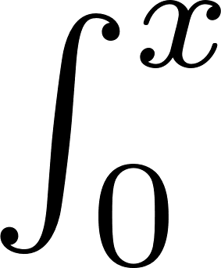
Exponential Random Variables pg 151
−λt
−λx
F_{exp}(x) = λe dt
= 1 − e
CS 355/555 Probability and Statistics for CS

Slide 31
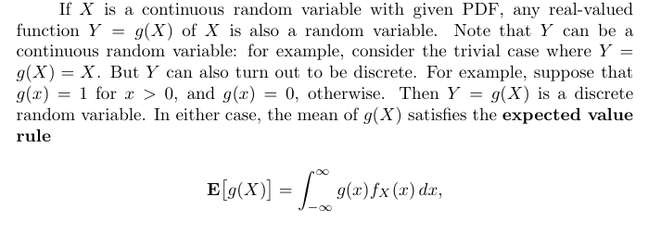

Slide 32
Next Class
Read 3.3, Normal Random Variables
CS 355/555 Probability and Statistics for CS

Slide 33
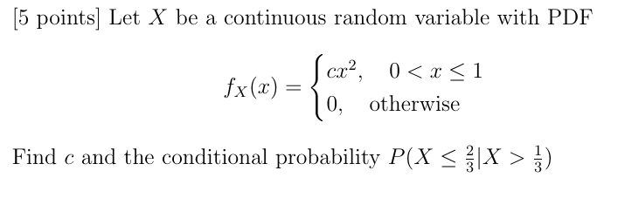
Quiz
CS 355/555 Probability and Statistics for CS

